Slide 1
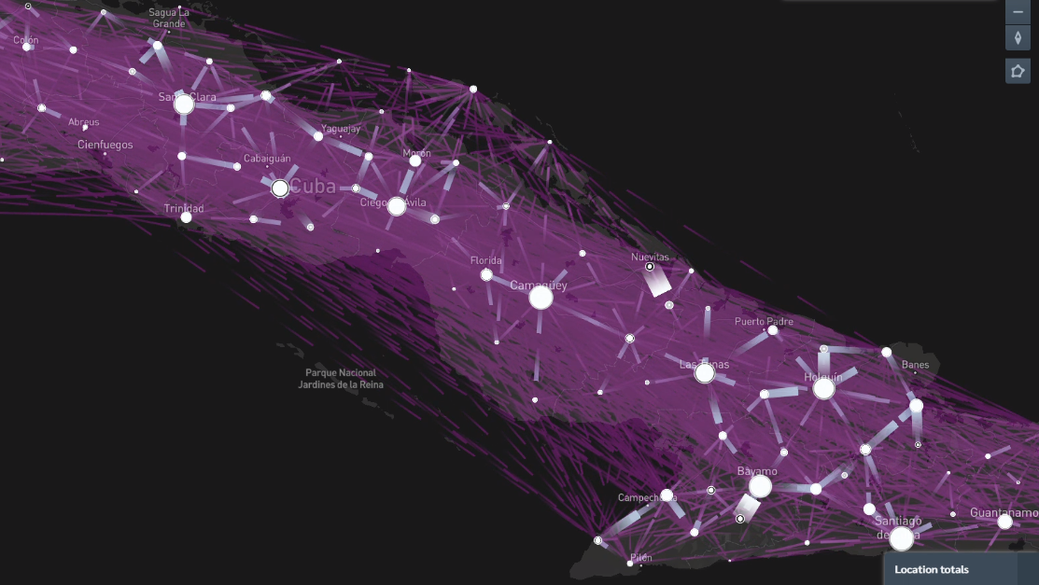

Epidemics on Networks
Dr. Alejandro Lage
Cuba
Facultad de Física, UH

Slide 2
Epidemics on Networks
What you get
Compartmental (SIR) models
Complex networks.
Simulations in python
Probability theory/Statistical mechanics.
Reconstruction of epidemics.

Slide 3
Epidemics on Networks
What you get
Compartmental (SIR) models
Complex networks.
Simulations in python
Probability theory/Statistical mechanics.
Reconstruction of epidemics.
What you need
Basic calculus
Probability theory
Basic programming
Statistical mechanics and/or combinatorial optimization

Slide 4
Epidemics on Networks
What you get
Compartmental (SIR) models
Complex networks.
Simulations in python
Probability theory/Statistical mechanics.
Reconstruction of epidemics.
What you need
Basic calculus
Probability theory
Basic programming
Statistical mechanics and/or combinatorial optimization
Who cares?
Working on epidemics
Working on inference
Working on networks
Working on optimization

Slide 5
Epidemics on Networks
Tema I: Modelos SIR campo medio
Tema II: Modelos SIR en redes
Tema III: Inferencia en epidemias
Tema IV: Modelos realistas de epidemias

Slide 6
Epidemics on Networks
1. Mathematical epidemiology, origins, early results. The compartmental model family.
2. The mean field description of SIR models. Short and long time limits in SIR.
3. Monte Carlo simulations of epidemics. Gillespie algorithm.
4. Monte Carlo simulations Practical Python Class.
5. Complex networks. Main results. Types and properties. Famous networks. Benchmarks.
6. Playing with networks in Python. Networkx. Plotting. Nice plotting.
7. Master equation of epidemics on networks. The mean field solution and pair based solution.
8. Simulating epidemics on networks. Python libraries.
9. Inference and belief propagation.
10. The zero patient problem. The contamination source detection problem.
11. The infectious backbone as a cascade process.
12. The effect of contact tracing.

Slide 7
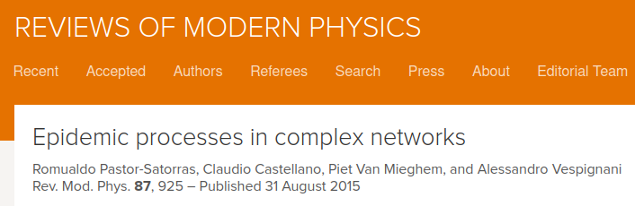
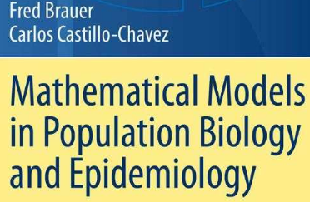
Mathematical epidemiology
1. Mathematical epidemiology, origins, early results. The compartmental model family.
2. The mean field description of SIR models. Short and long time limits in SIR.

Slide 8
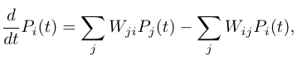
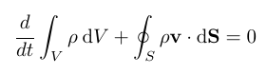
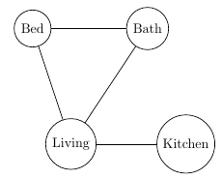
Master equation
Stochastic procceses:
Set of states
Transition rates
Distribution over states
Conservation of mass → probability
Classical example: Random walk in a graph

Slide 9
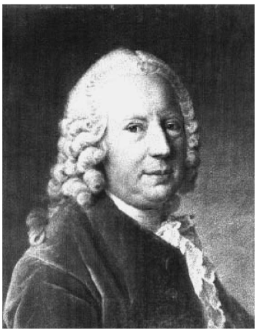
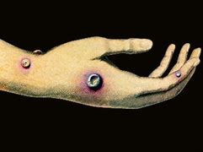
Smallpox in xiii century
1760-1766 Daniel Bernoulli at Royal Academy of Science
Effects of smallpox on life expentancy.

Slide 10
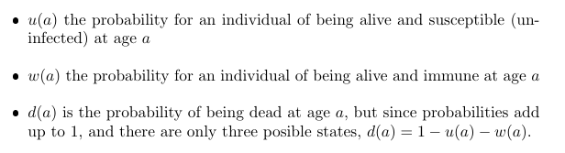
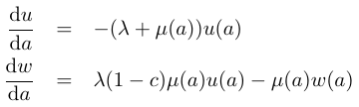
Smallpox in xiii century
1760-1766 Daniel Bernoulli at Royal Academy of Science
Effects of smallpox on life expentancy.

Slide 11
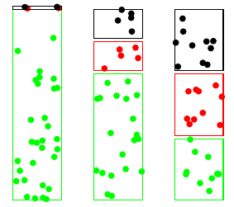
Smallpox in xiii century
Compartments contains people of a certain category
Compartments are:
Susceptible
Immune
Dead

Slide 12
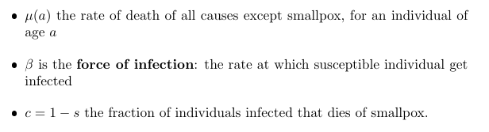
Smallpox in xiii century
Compartments contains people of a certain category
Compartments are:
Susceptible
Immune
Dead
S
I
D

Slide 13
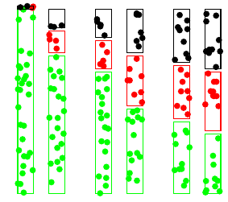
Smallpox in xiii century
Compartments contains people of a certain category
Compartments are:
Susceptible
Immune
Dead
S
I
D

Slide 14
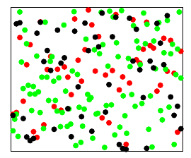
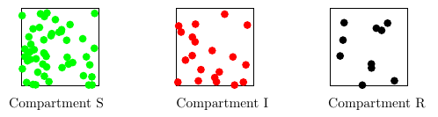
Compartmental models
A gas of persons
Stochastic Process
Analitic: Master equation
Analitic: generating functions
Numeical: Monte Carlo simulation (Gillespie Alrogirthm)

Slide 15
Compartmental models
A gas of persons
Stochastic Process
Analitic: Master equation
Analitic: generating functions
Numeical: Monte Carlo simulation (Gillespie Alrogirthm)
What are the states of an SIR model?
Derive the deterministic equation from an average of Master equation!

Slide 16
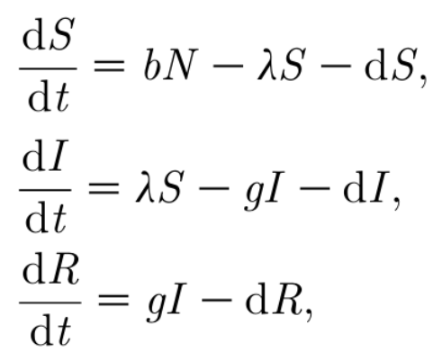
Compartmental models
A gas of persons
Stochastic Process
Analitic: Master equation
Analitic: generating functions
Numeical: Monte Carlo simulation (Gillespie Alrogirthm)
Deterministic process (Meanfield)

Slide 17
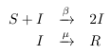
Compartmental models
A gas of persons
Chemical reactions

Slide 18
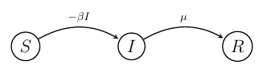
Compartmental models
A gas of persons
Chemical reactions
Compartmental model:
Mean field approximation
Well mixed
No spatial correlations

Slide 19
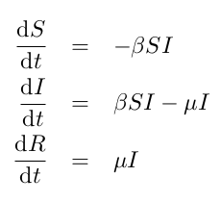
Compartmental models
Chemical reactions
Compartmental model:
Mean field approximation
Well mixed
No spatial correlations

Slide 20
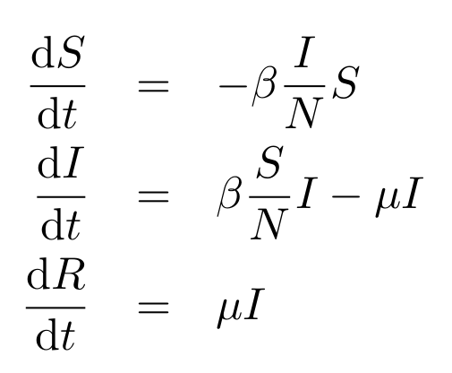
Compartmental models
Probabilities
Chemical reactions
Extensive

Slide 21
SIR details and terms
Probabilities
Whats is the average duration of infection?
Extensive

Slide 22
Technical terms
Technical terms

Slide 23
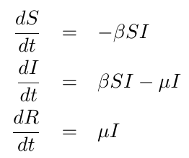
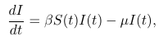
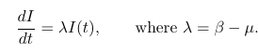
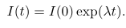
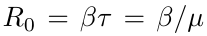
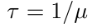
Early epidemics
Attention, exponentials
Basic reproduction number

Slide 24
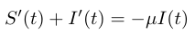
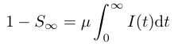
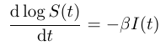
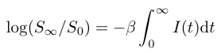
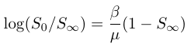
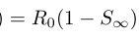
Large time limit

Slide 25
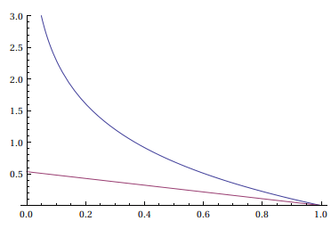
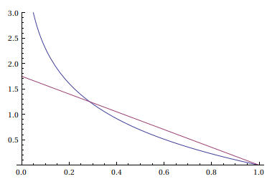
Large time limit

Slide 26
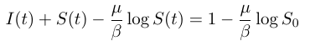
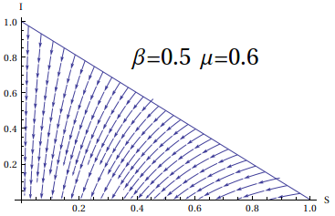
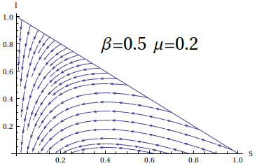
Large time limit

Slide 27
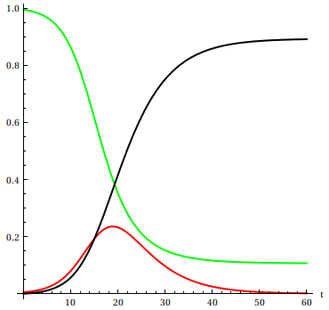
Finite time Integration

Slide 28
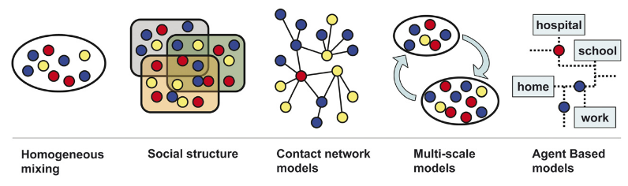
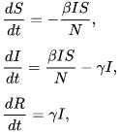
Beyond sir
"Contributions to the mathematical theory of epidemics – I and II". Bulletin of Mathematical Biology. 53 (1–2) 33–55

Slide 29
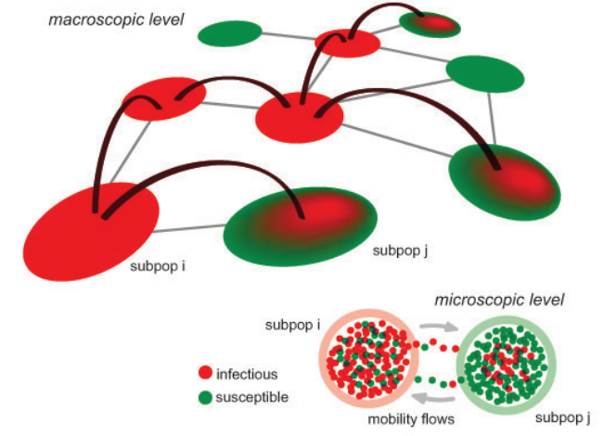
SIR
Space
Compartments
Time
Geographic patches:
Countries, Cities, provinces, municipalities
Mobility patterns
Household, wokrplace, schools, commuters
Age patches:
Seasonality
Virus mutation
Non pharmocolical measu

Slide 30
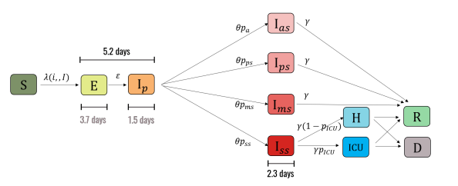
SIR
Space
Compartments
Exposed
Symptomatic vs Asymptomatic
Quarantained
Immune
Time
Geographic patches:
Countries, Cities, provinces, municipalities
Mobility patterns
Household, wokrplace, schools, commuters
Age patches:
Seasonality
Virus mutation
Non pharmocolical measu

Slide 31
SIR
Space
Compartments
Exposed
Symptomatic vs Asymptomatic
Quarantained
Immune
Time
Geographic patches:
Countries, Cities, provinces, municipalities
Mobility patterns
Household, wokrplace, schools, commuters
Age patches:
Seasonality
Virus mutation
Non pharmocolical measu
Parameters in time:
Seasonality
Virus mutation
Non pharmocolical measures
Vaccination

Slide 32
ModelinG epidemics

Slide 33
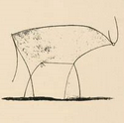
ModelinG epidemics
Simple
Un-specific

Slide 34
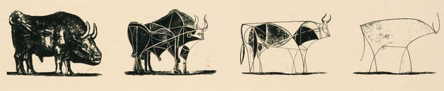
ModelinG epidemics
Simple
Un-specific
Complex
Specific

Slide 35
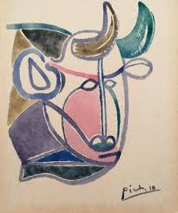
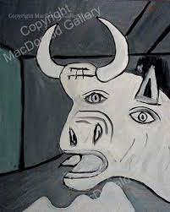
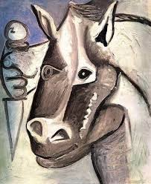
ModelinG epidemics
Complex
Specific
Hard to fit
Simple
Un-especific

Slide 36
Epidemics on networks
Not what you think!

Slide 37
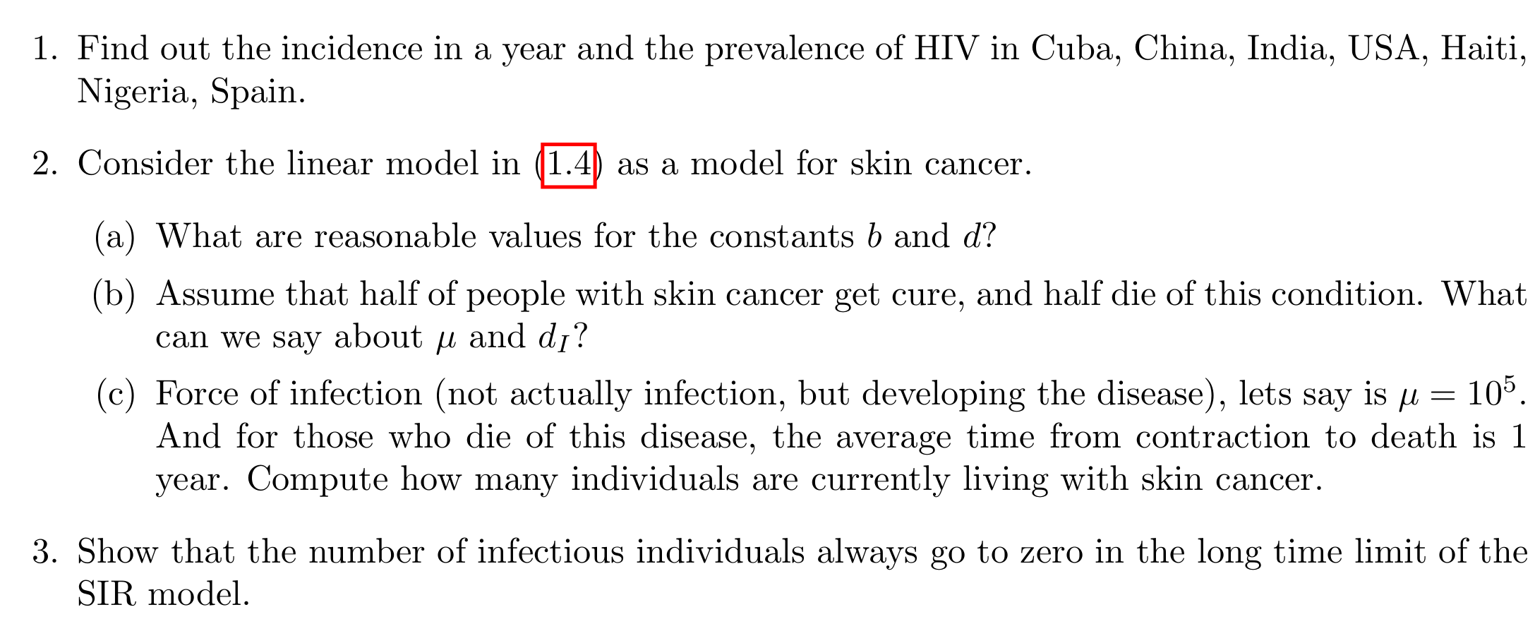
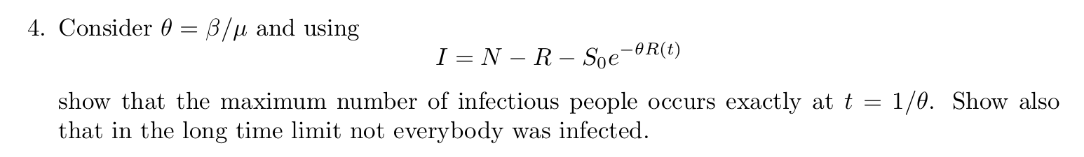
Homework

Slide 38
Next class
Introduction to graphs and networks
Graph metrics
Graphs for benchmarking
Representing graphs on Python

